Slide 1
CFD simulation report
For YPF DC

Slide 2
Contents
Part one: Model
    Layout and Parameter Settings
    Data room Main parameters Settings
    layout of devices
Part two: Analysis Result
    Two air conditioner down
    Rack Over-heat situation
    Average inlet temperature of the cabinet
    Cross section temperature distribution
    Air conditioner airflow organization
    Part three: Result & Summary

Slide 3
Part one: Model Development

Slide 4
  Layout and Parameter Settings
Data Hall Main parameters Settings
Air Conditioner
  NetCol5000-A035H
  Net sensible cooling capacity:32.2kW
  Air flow rate: 6000 m³/h/pcs
  Supply / Return air temperature: 19℃/35℃
  Number of air conditioners: 10+2 pcs
  Total cooling capacity of Data Hall :10*32.2=322kW
  Cold load
  IT Equipment heat dissipation: 48*6kW=288kW
Other
  Cold aisle
  Clear height of the room : 2.8m

Slide 5
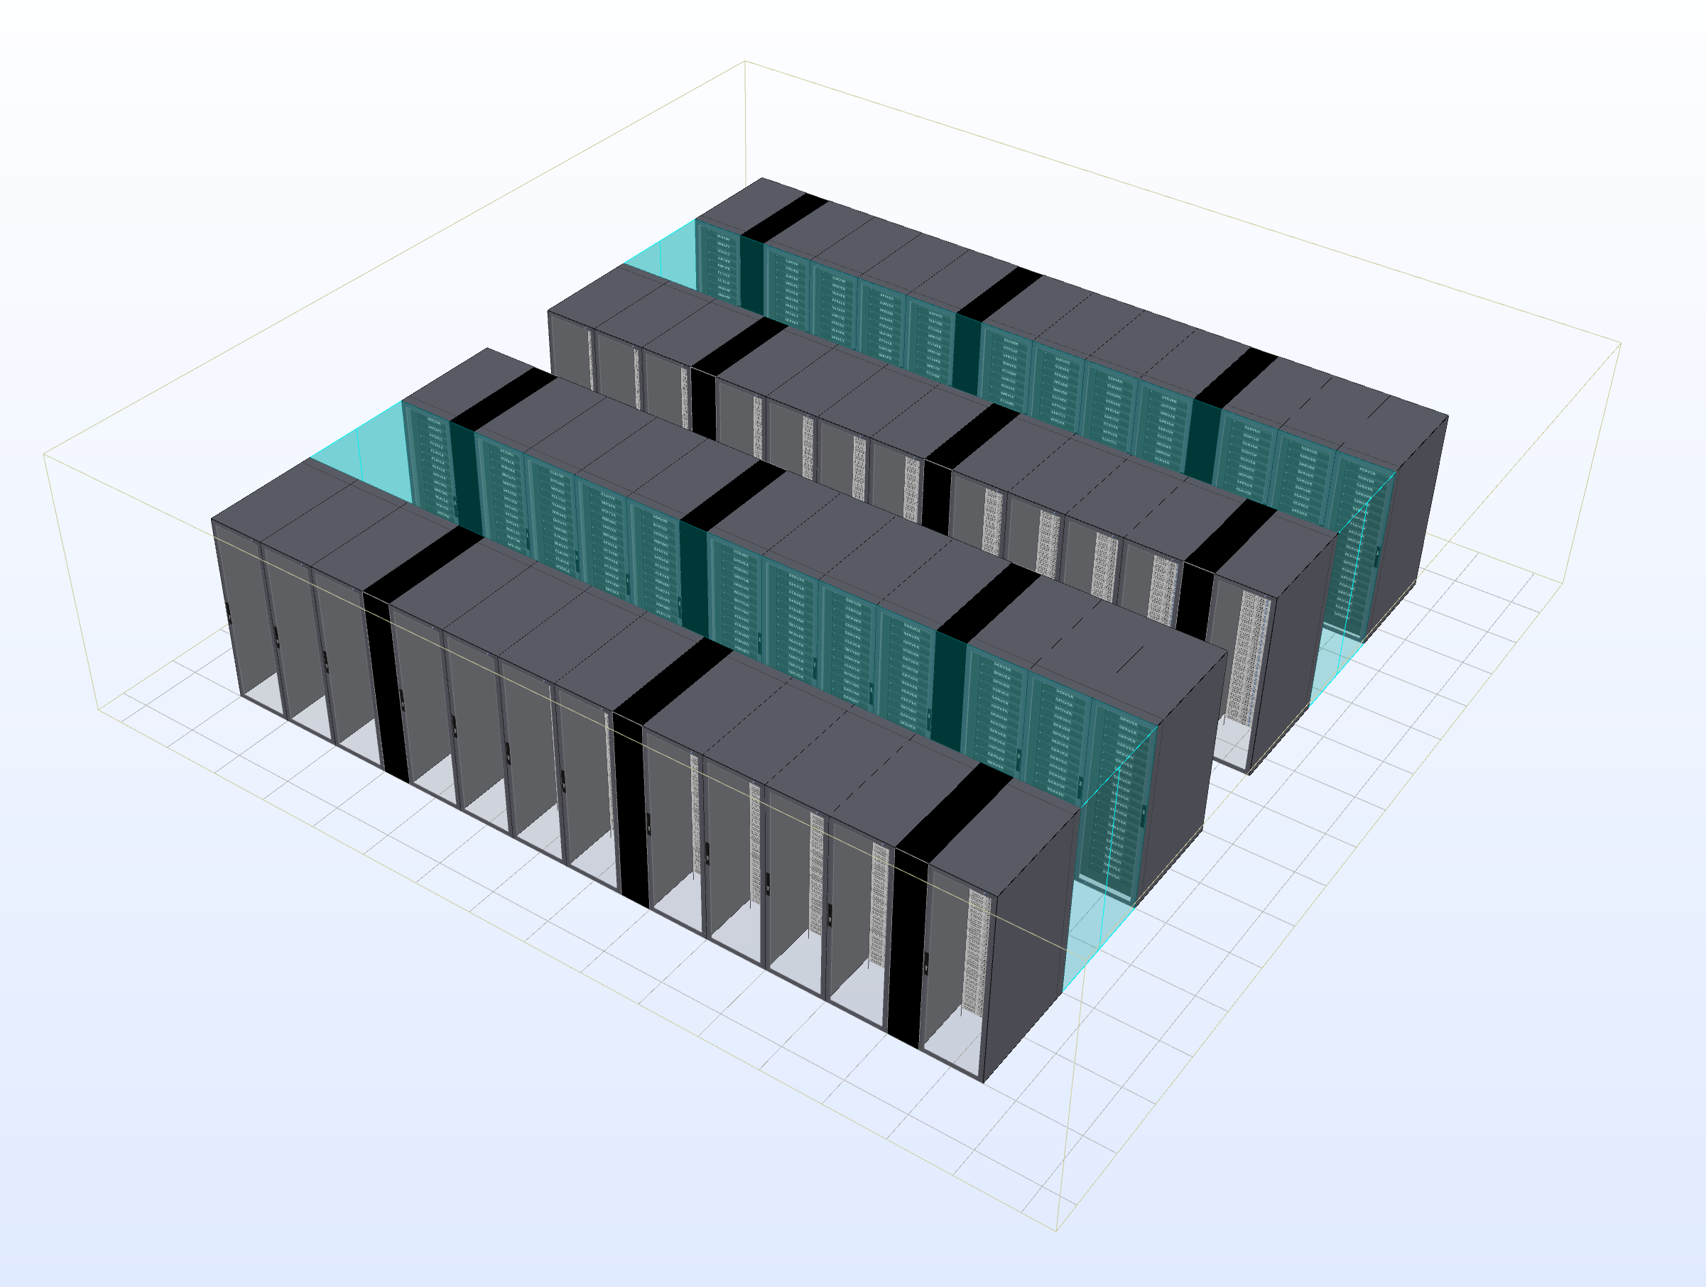
  Layout

Slide 6
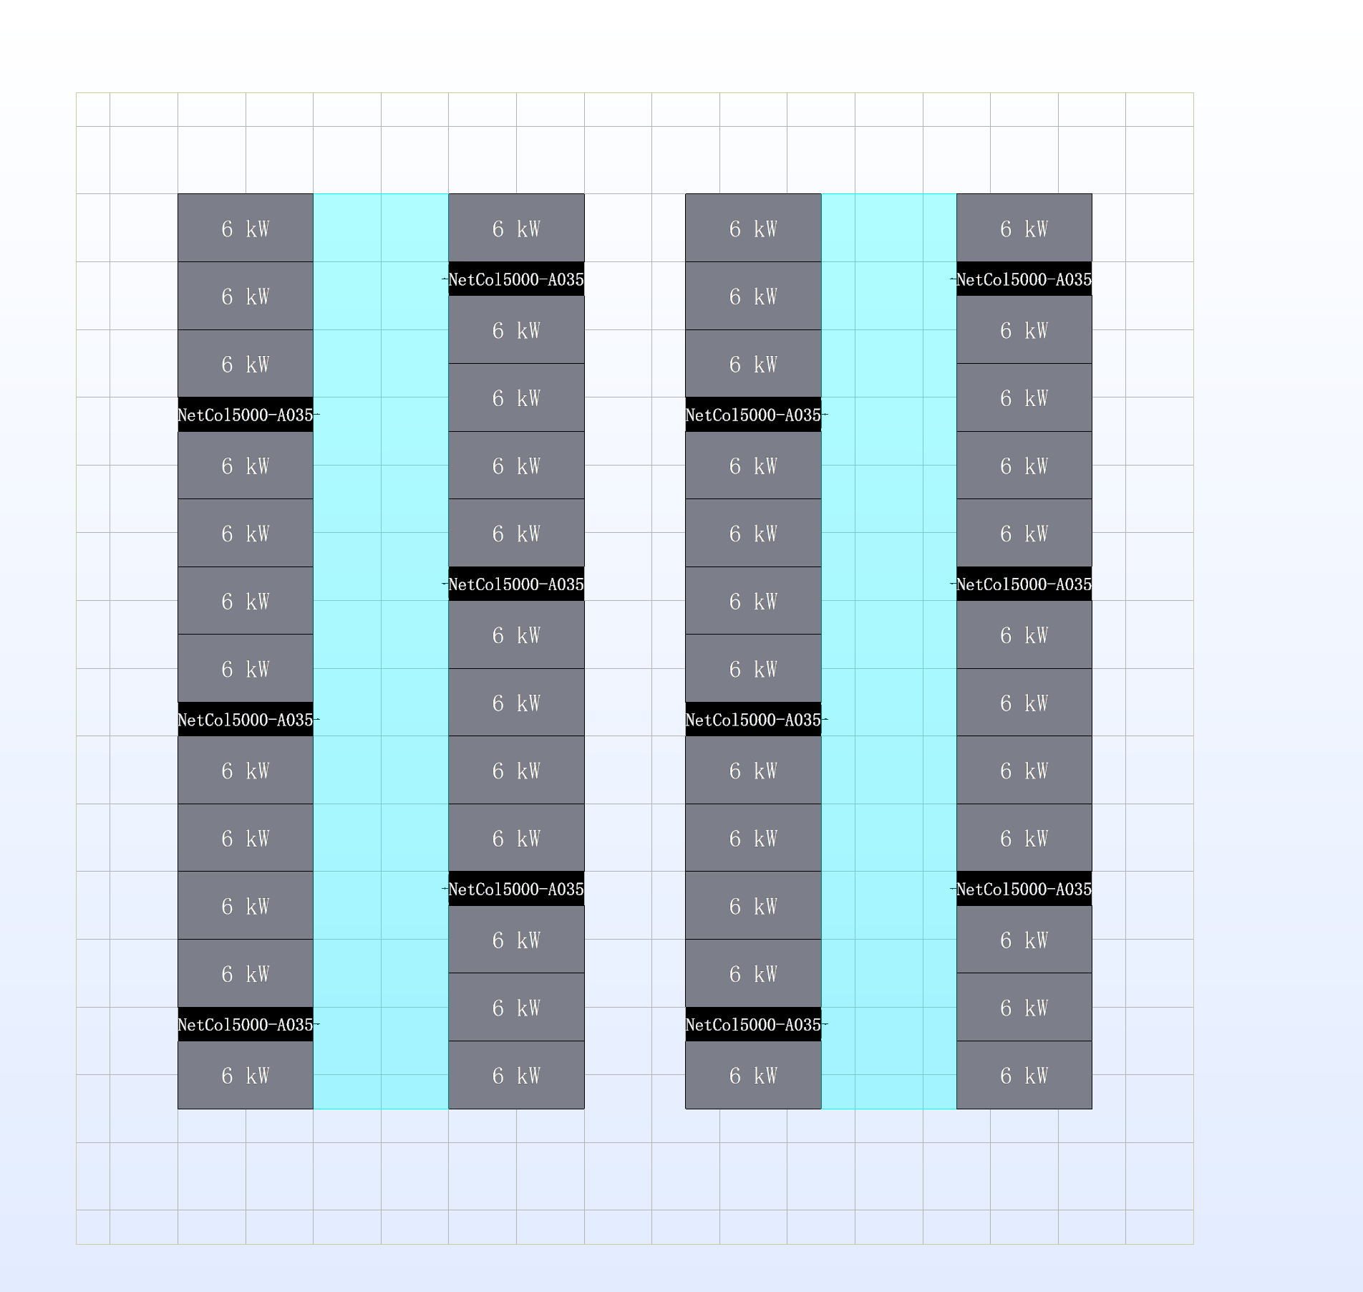
  Layout

Slide 7
Part two: Analysis Result

Slide 8
Two air conditioner down, the CFD result and Analysis shows as below.

Slide 9
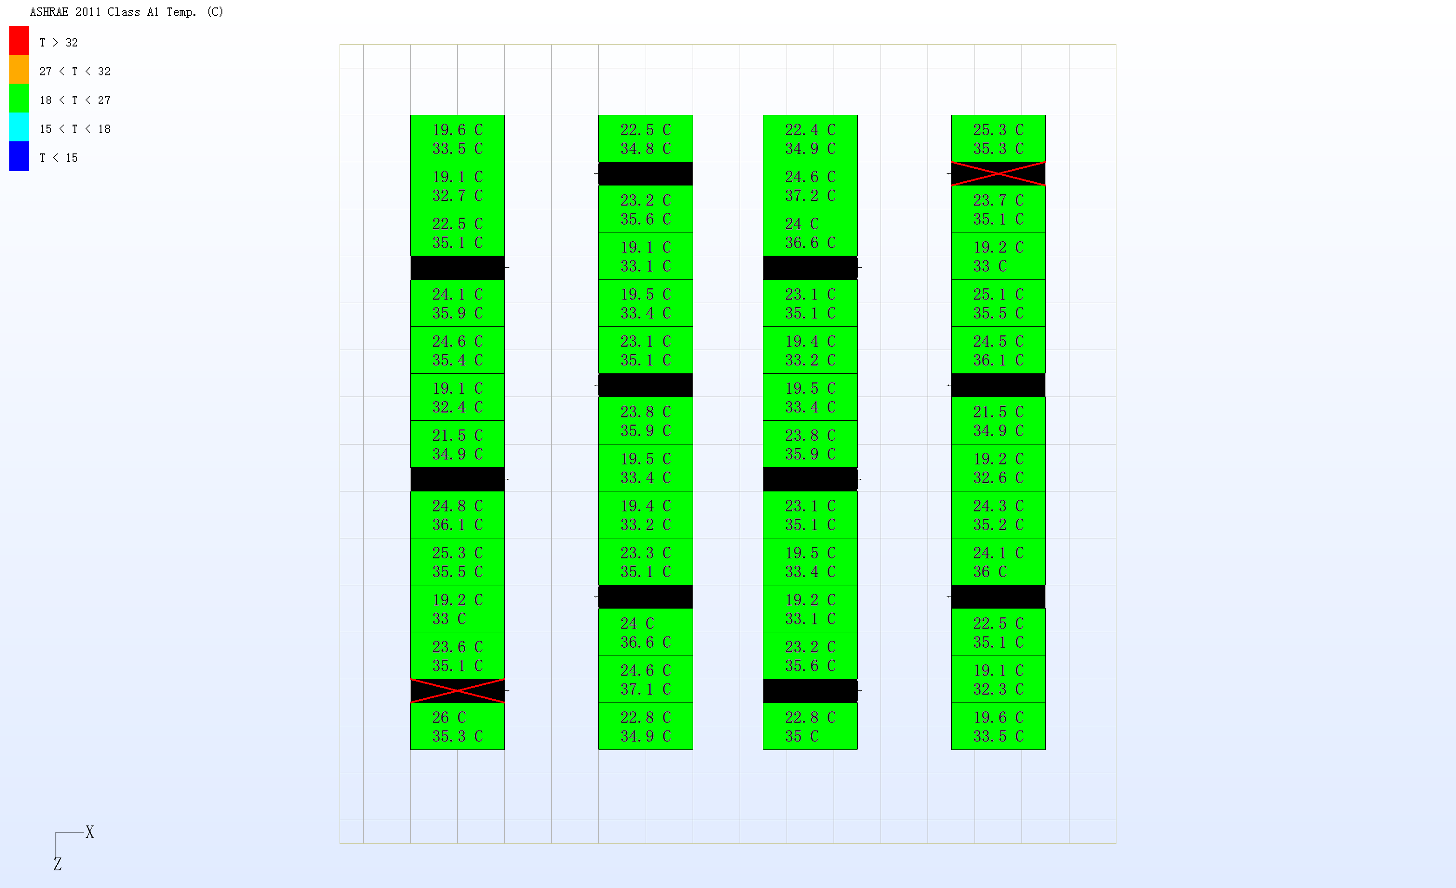
Two Air-conditioner turn off
Rack Over-heat situation
Maximum inlet Temp:26℃
Maximum outlet Temp: 35.3℃

Slide 10
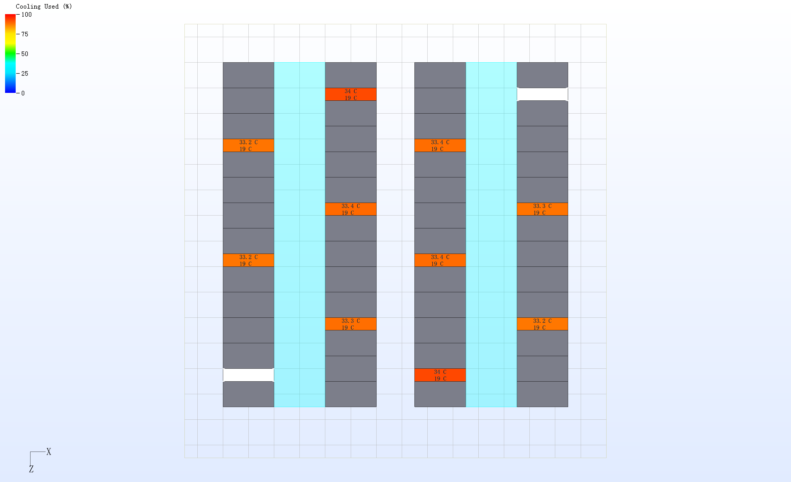
Two Air-conditioner turn off
Mean return and supply temperature of the A/C

Slide 11
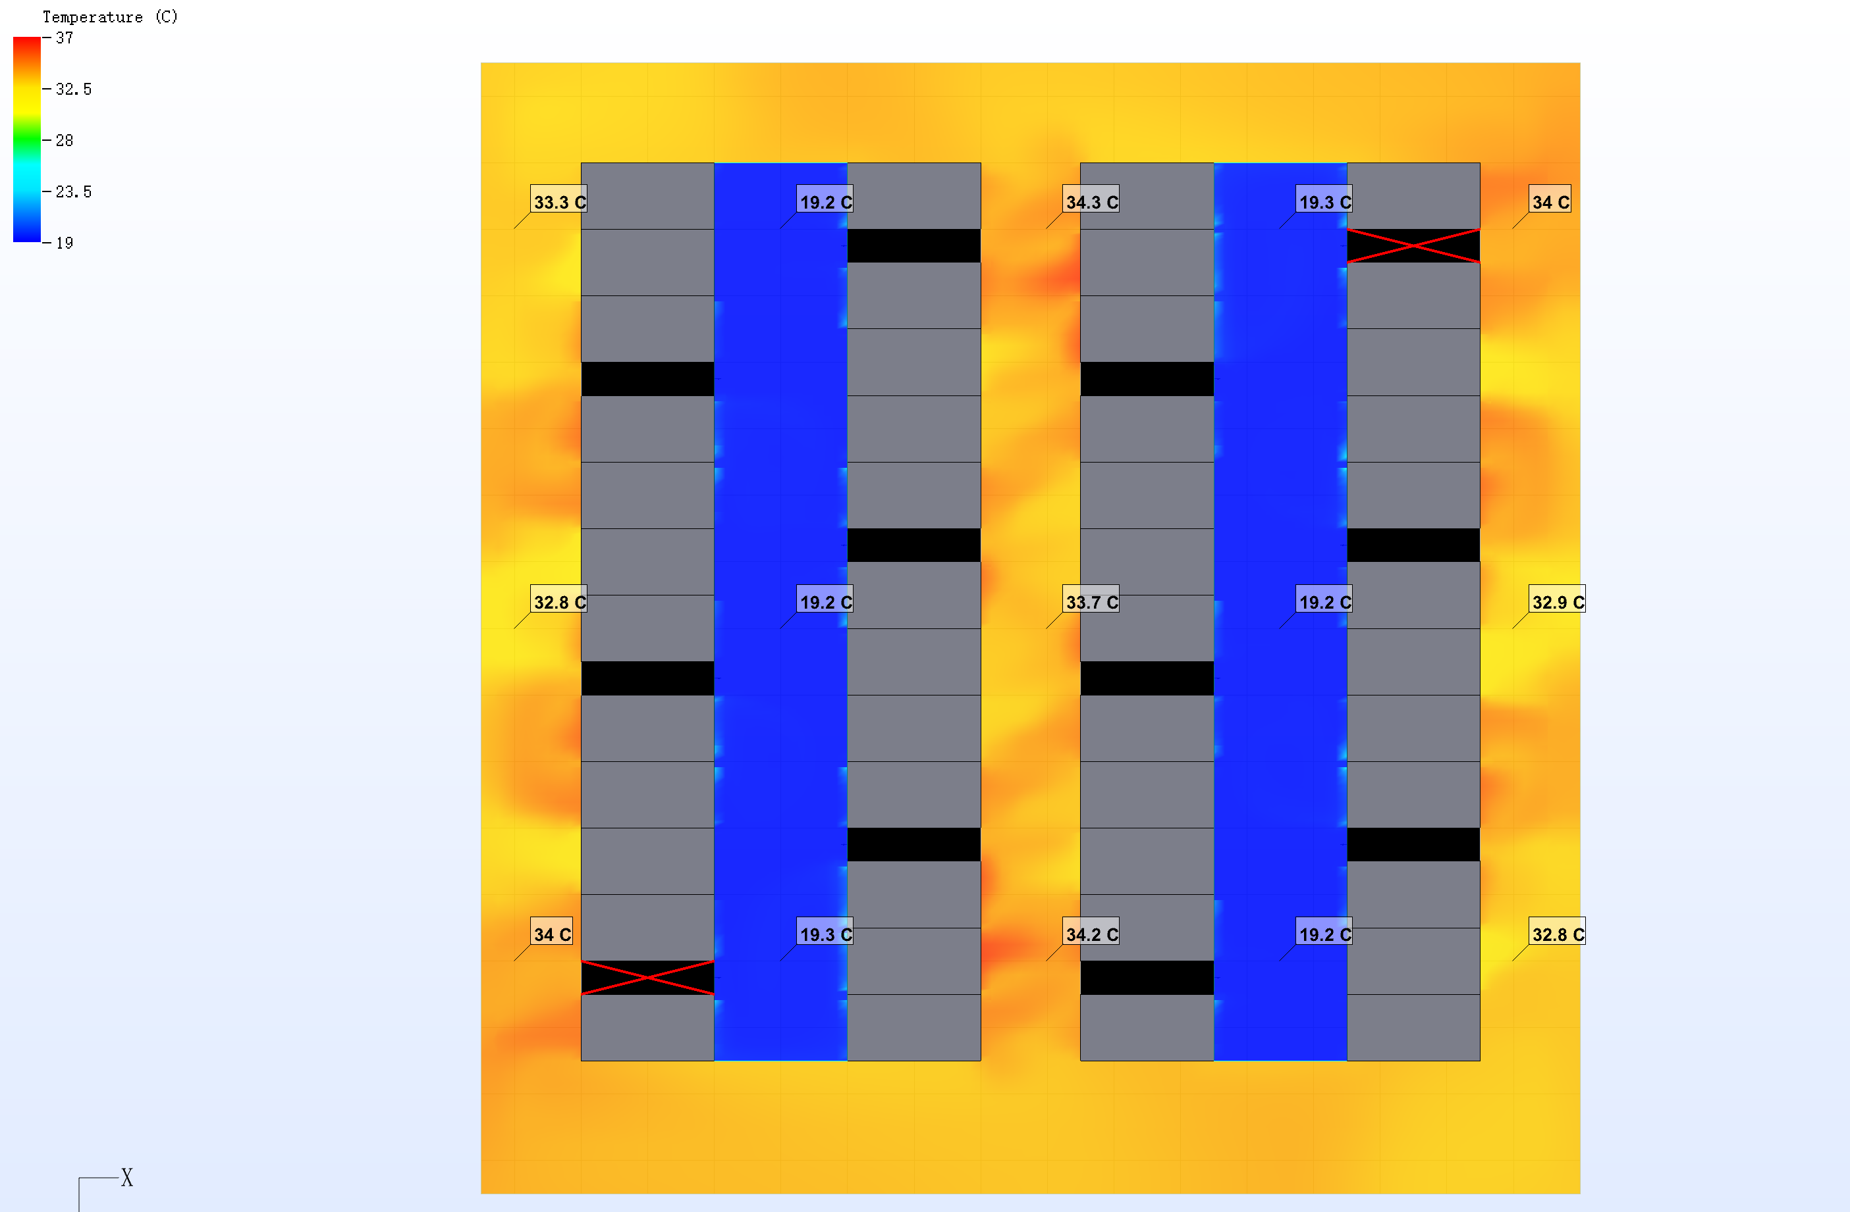
Two Air-conditioner turn off
Cross section temperature distribution(1.8m above the floor)

Slide 12
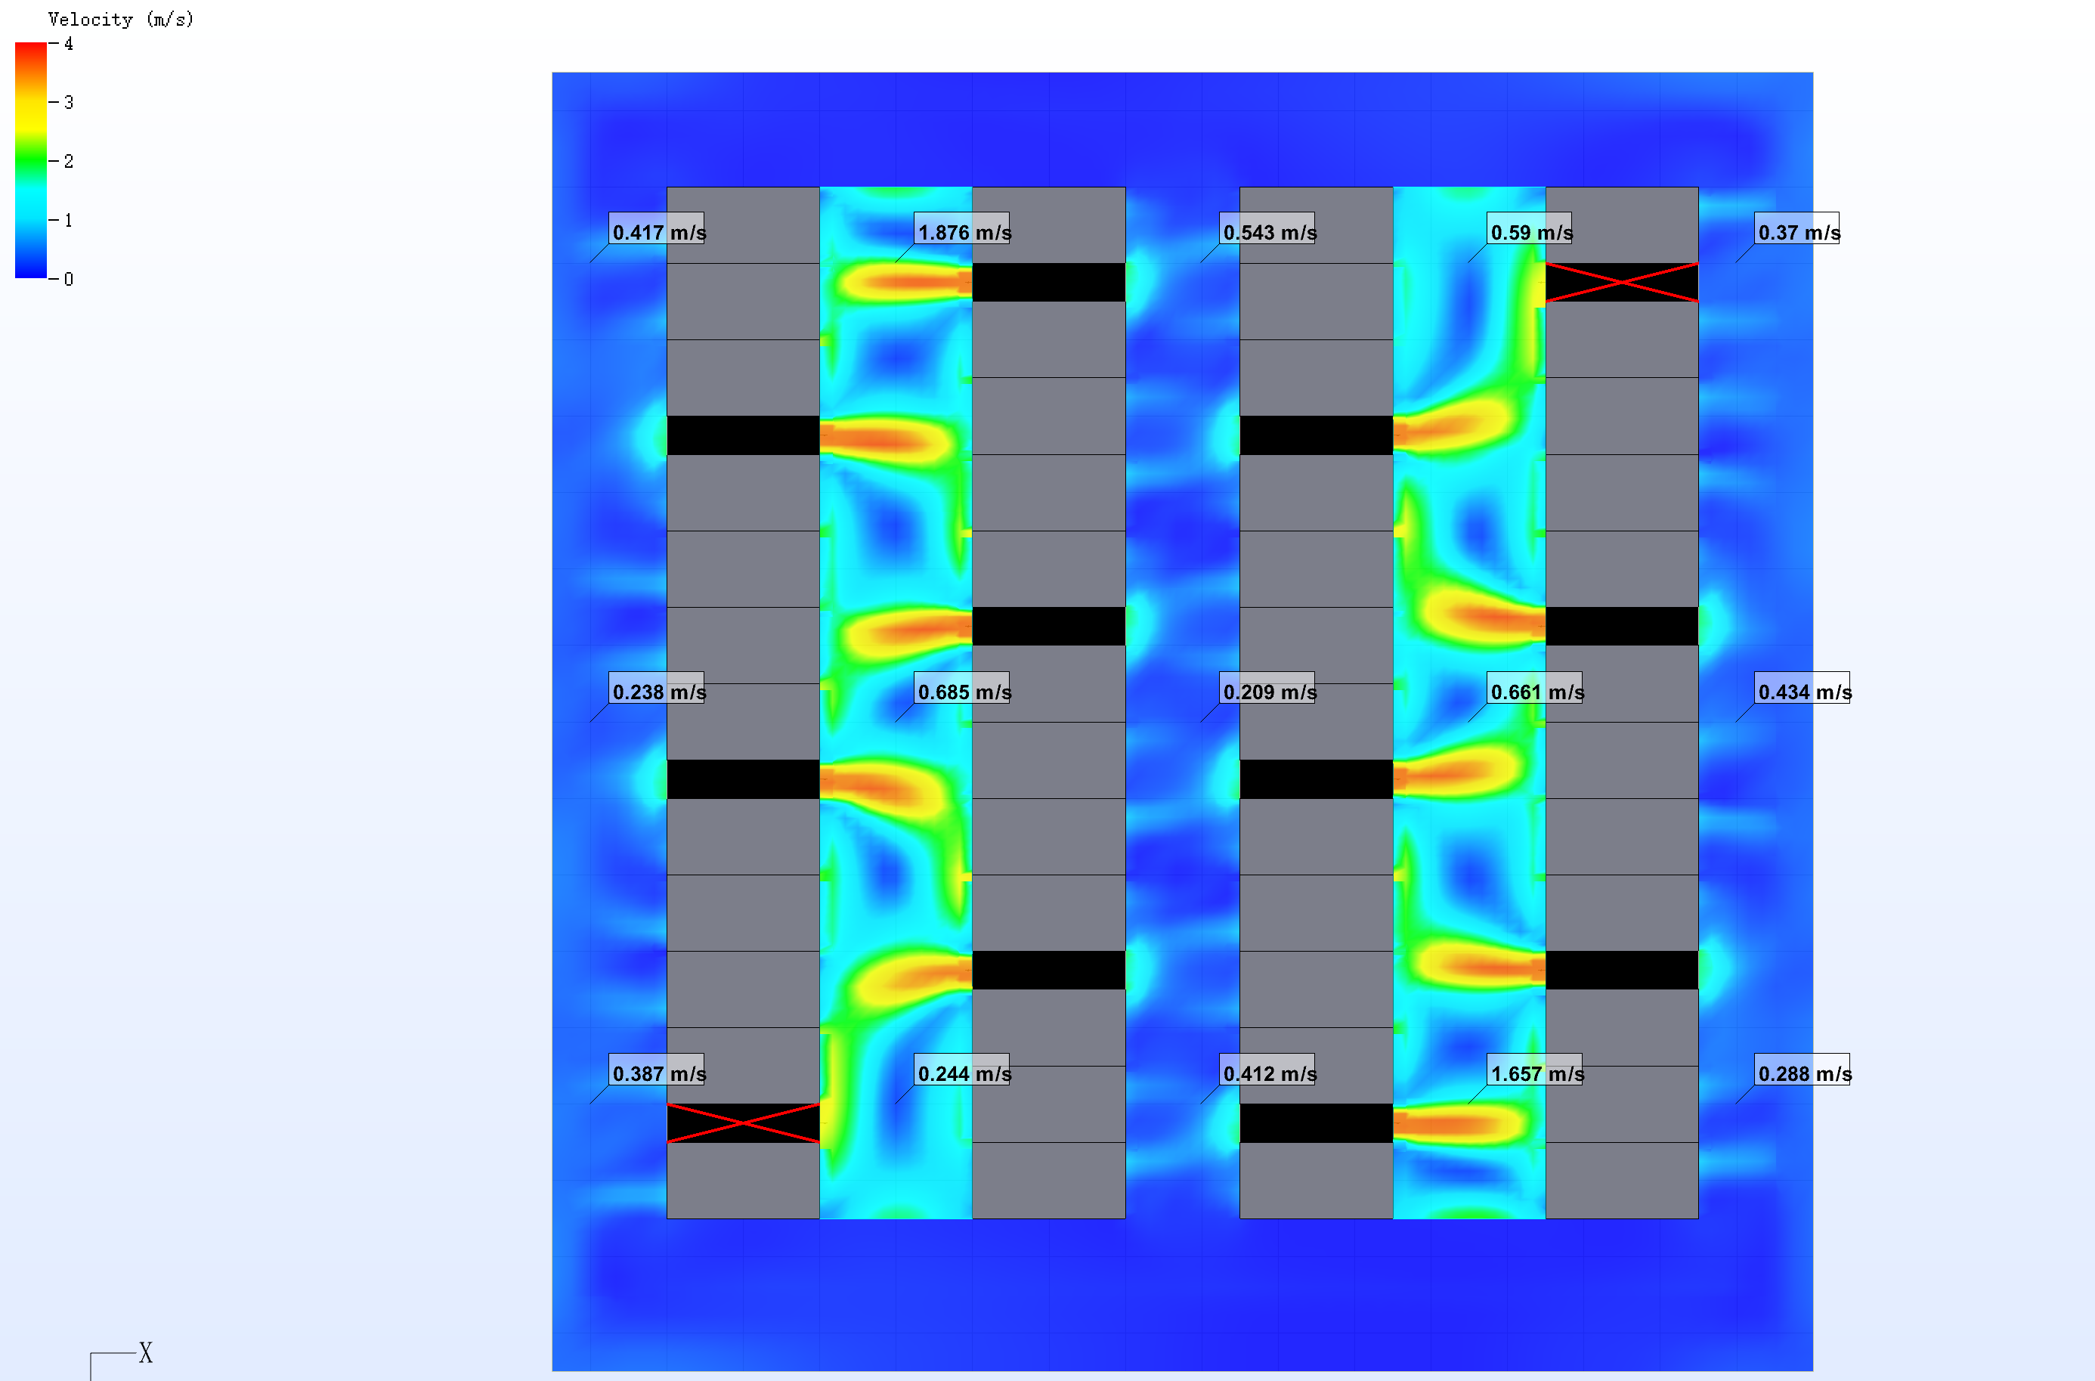
Two Air-conditioner turn off
Cross section velocity distribution(1.8m above the floor)

Slide 13
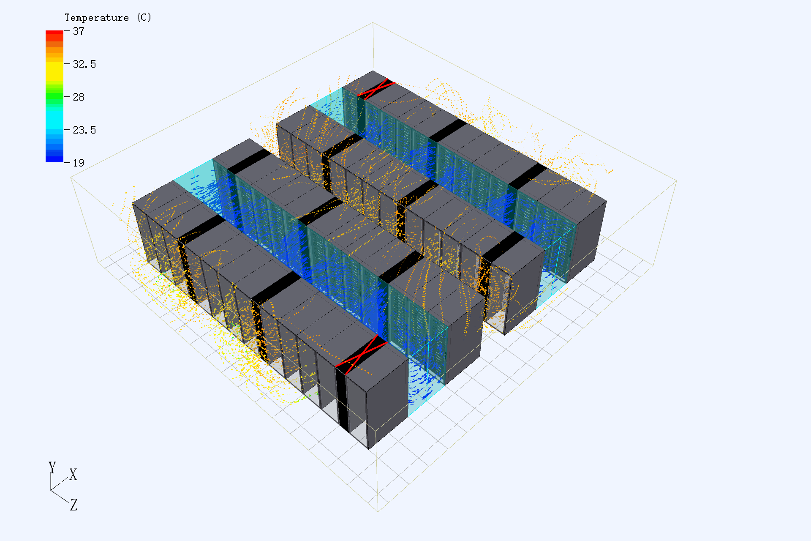
Two Air-conditioner turn off
Air conditioner airflow organization(3D view)

Slide 14
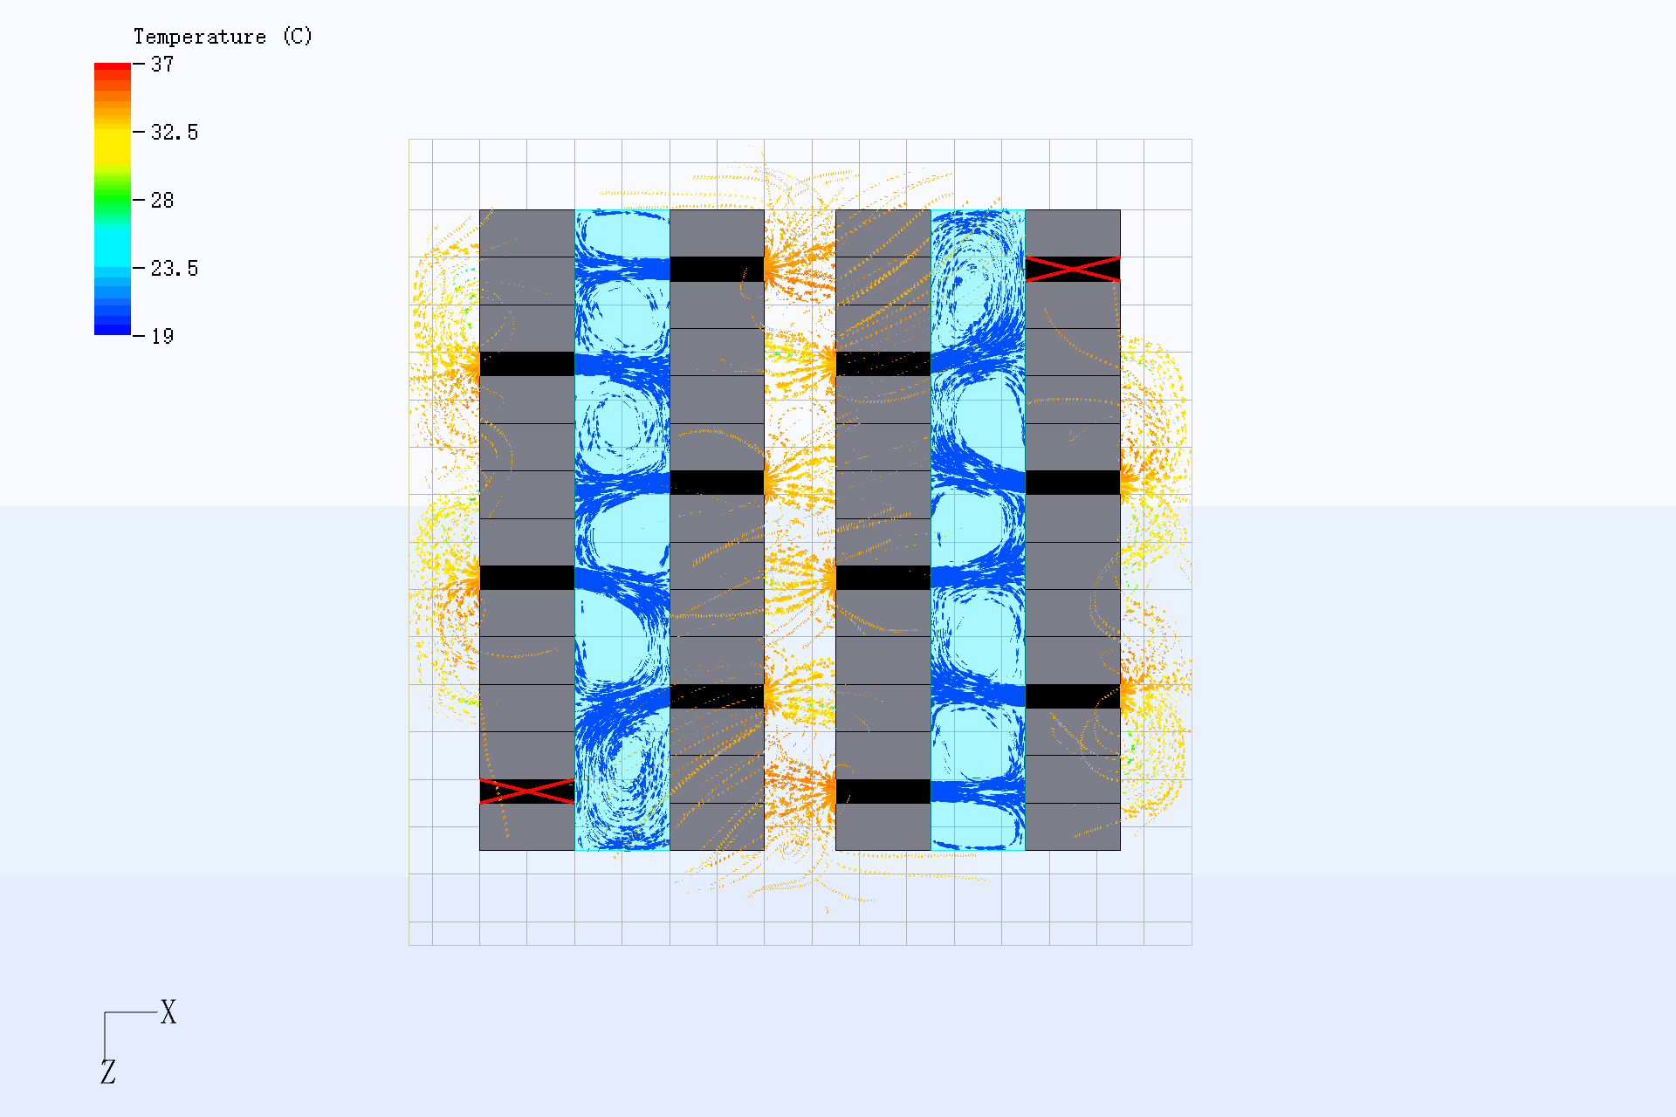
Two Air-conditioner turn off
Air conditioner airflow organization(top view)

Slide 15
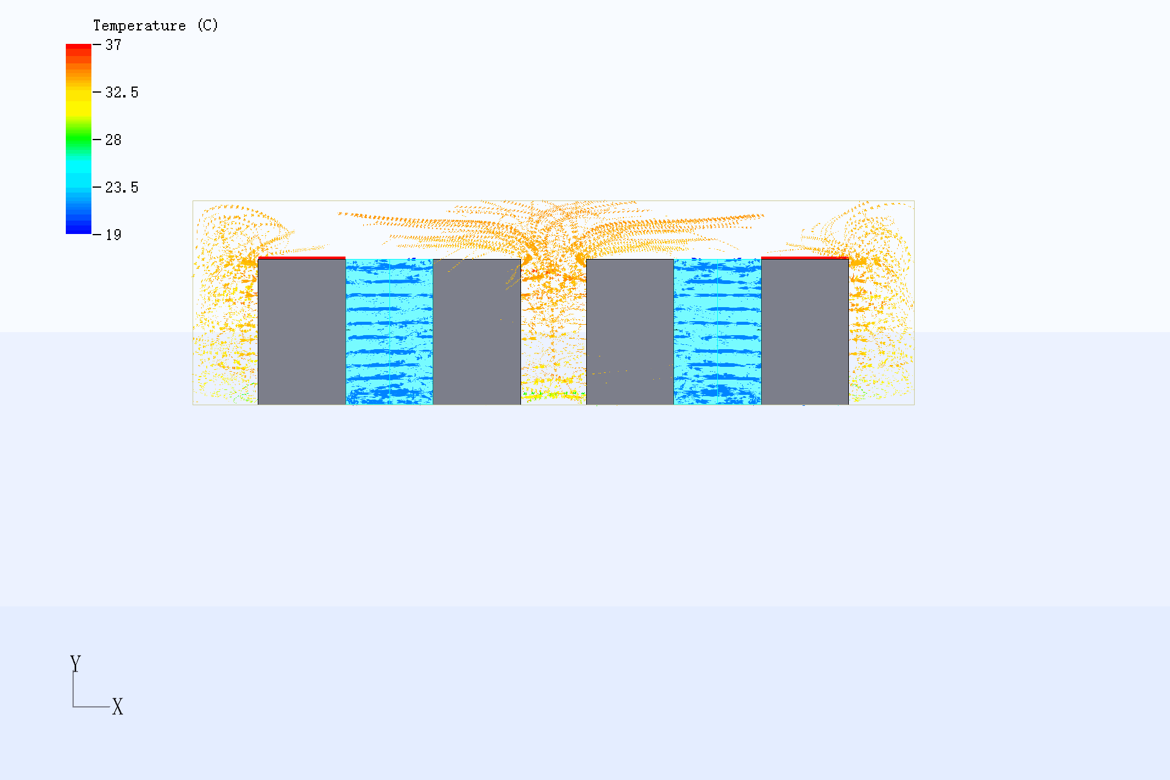
Two Air-conditioner turn off
Air conditioner airflow organization(side view)

Slide 16
Summary
  In Data Hall, the temperature is uniformed,separation of cold air and hot air .
  The temperature of the room is less than 35℃，and the temperature of cold aisle is about 19℃
  The velocity in cold aisle is less than 2m/s.
  When two air conditioner shut down, the cooling capacity and air volume of the air conditioner meet the actual load requirements, and no rack is overheated.
  The CFD simulation result is a guide and suggestion. It can only be used as a guide and suggestion for engineering practice.

Slide 17
THANK YOU!

